Slide 1
Media Show
Under Supervision:
Dr.Khaled Fatehy Hussein
Prepared By:
Hind Mohamed
Heidi Sayed
Noura Shaban
Nahed Nageib

Slide 2
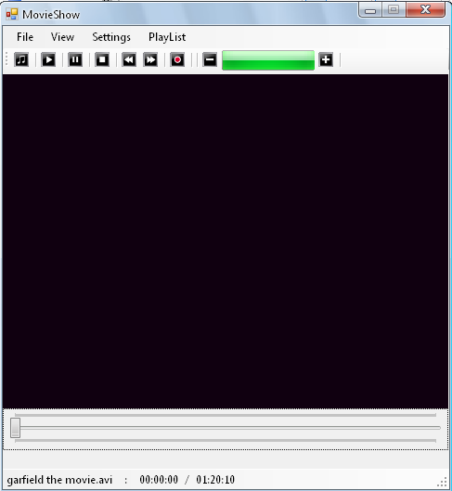
Media Show

Slide 3
It is based on the famous DirectShow multimedia API from Microsoft.
DirectShow divides the processing of multimedia tasks such as video playback into a set of steps known as filters .
Each filter represents a stage in the processing of the data.
Filters have a number of input and output pins which connect them together .
The generic design of the connection mechanism means that filters can be connected in many different ways for different tasks to build a filter graph .
This sample program shows, how simple it is to play a video or an audio track with Media Show and C#.

Slide 4
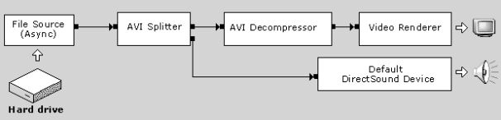
The Media Show Interface
To play videos or audio files we use the Direct Show Component of the DirectX Package.
With the Media Show Interface it is very simple to play a video or an audio file.

Slide 5
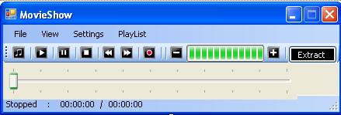
Features
We used a C# example of media playback with Media Show and modified it to suit our requirements. The following features are there in Media Show :

Slide 6
Features (Cont.)
Play media/audio files (WAV, WMA, **MOV, QT, AVI, DAT, MP3, MPEG/MPG)
Play list in a new format(*.ms)
Voice Recorder
CD tray Open and Close
Subtitles Play.
Set rate of play of file.
Single frame step which displays one frame at a time until the user presses a key to move to the next frame.
Different Screen Modes.
Volume Control.
Mute option.
Position Track bar to jump to desired position.
Displays the total duration of file
Displays the duration of play of file.
Extracts still pictures from Movie File.

Slide 7
create the Media Show Interface select the media file
After the user pressed the "File -> Open..." Command of the MainMenu Control, a "Open File" Dialog is shown and the user can select the desired media file. In C# this is done by creating a instance of the OpenFileDialog class and call the ShowDialog() function.
OpenFileDialog openFileDialog = new OpenFileDialog();openFileDialog.Filter = "Media Files|*.mpg;*.avi;*.wma;*.mov;" + "*.wav;*.mp2;*.mp3|All Files|*.*";if (DialogResult.OK == openFileDialog.ShowDialog())
After the user terminated the dialog with OK, we begin to create the Media Show Interface and to render the selected media file.

Slide 8
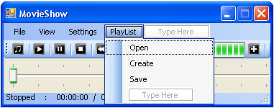
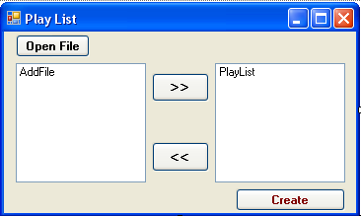
Play List
You can open, create and save a playlist

Slide 9
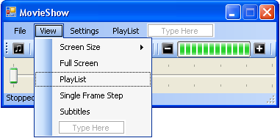
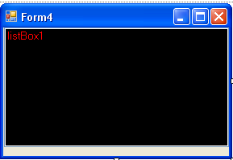
Play List (Cont)
To play a saved play list click on view playlist
Play list window

Slide 10
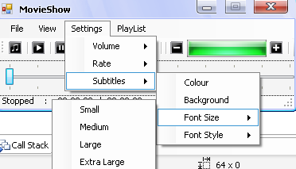
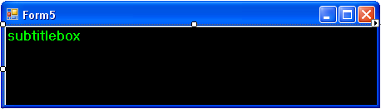
Subtitle
The Subtitle of video file will appear in a new window

Slide 11
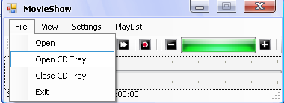
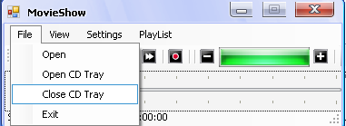
CD tray Open and Close

Slide 12
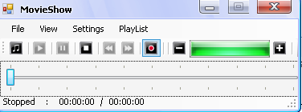
Voice Recorder

Slide 13
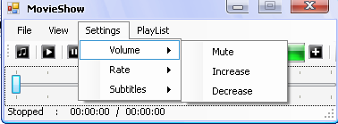
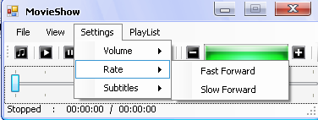
Volume Control & Set rate of play of file

Slide 14

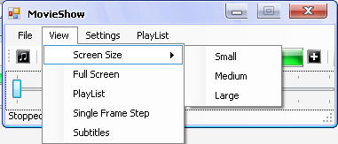
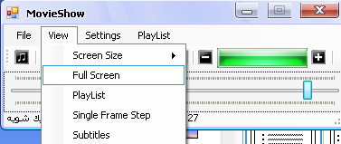
Display the Total Duration of File & Different Screen Modes

Slide 15
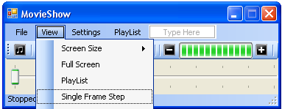
Single Frame Step
If you want to move the file fixed frame step (single time ) use single frame step

Slide 16
Extracting still pictures from movie files
Pressing the "Print Screen" key while playing a movie file in Windows Media Player will not allow you to save the current frame.
This is a simple way to grab a frame from movie files playing in the most common media applications (e.g., Windows Media Player, QuickTime, or DivX Player).
It can extract frames from most movie file formats including *.wm? (Windows Media Player), *.avi, *.mpeg, *.mov (QuickTime), and *.dat (DivX).
The application extracts a frame every second, by default.

Slide 17
Using the code
By wrapping the qedit.dll from the DirectShow Developer Runtime (which is included in the Extras of the DirectX SDK) in a managed assembly, you could make calls to MediaDetClass::WriteBitmapBits method that saves a frame from a movie file to a bitmap file.
the workhorse of the application is the WriteBitmapBits method of the class MediaDetClass.
In order to be able to access this method, you need to add a reference (from Visual Studio menu, Project/Add Reference if you are using Visual Studio, or use tlbimp from the .NET Framework tools) to the qedit.dll.

Slide 18
Using the code (Cont)
To declare an object of the MediaDetClass, you'll see code like:
MediaDetClass md = new MediaDetClass(); md.Filename = "sample.mov"; md.CurrentStream = 0; string fBitmapName = "sample" + ".bmp" ; md.WriteBitmapBits( 0, 320, 240, fBitmapName );
The important thing to know about this is that you need to create a new MediaDetClass instance anytime you need to load a new movie (it is a little as if the properties of this class are "read only").

Slide 19
In order to save disk space, we have added code to convert the bitmap file to a JPEG one.
The MediaDetClass as imported with Visual Studio is not a Windows control, its base class is System. Object, and it seems that after calling the method WriteBitmapBits, a handle to the bitmap file just created stays open.

Slide 20
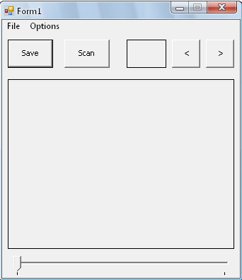
Image Extractor
The application extracts a frame every second, by default.
Under the Options menu, you can choose to extract a frame every one tenth of a second. This is only taken in consideration when you press the "Scan" button.

Slide 21
Description
The application only saves a bitmap with the resolution 320 x 240. And they are saved in the "tmp" subdirectory (that will be created when you run the application).
The application is meant to extract pictures from movie files and is a poor application for viewing movies.
we have created a thread to be able to keep track of the progress so far (which is displayed on a static label) when scanning a whole movie.
The thread only updates the label.
The length of the movie is immediately overwritten when opening a second movie with the current position.

Slide 22

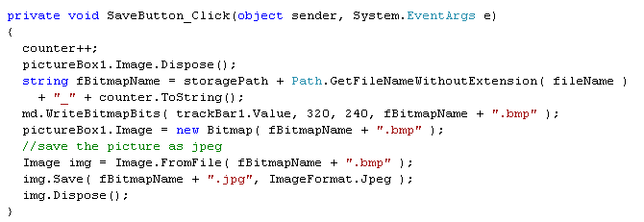
Save Button
The "Save" button saves the current frame to a JPEG file in the "tmp" subdirectory.

Slide 23

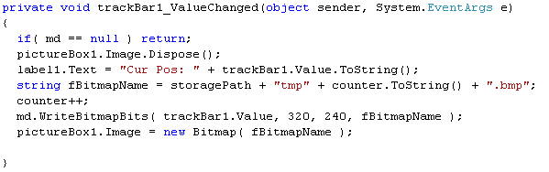
Track bar
You can use the trackbar to reach a selected position to extract image.

Slide 24


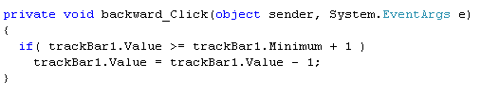

Forward & Backward
Or you can use the Forward and Backward buttons to control the image position.

Slide 25

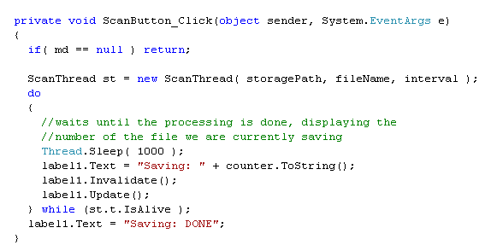
Scan Button
"Scan" button loops through the whole movie and saves a frame every second (or 0.1 second).

Slide 26
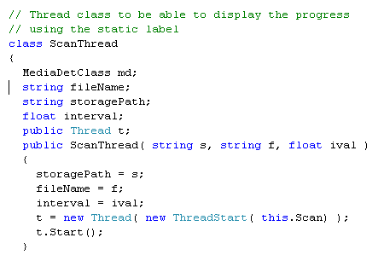
Scan Button (Cont)

Slide 27
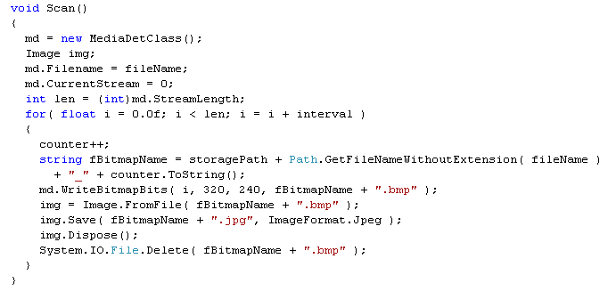
Scan Button (Cont)

Slide 28
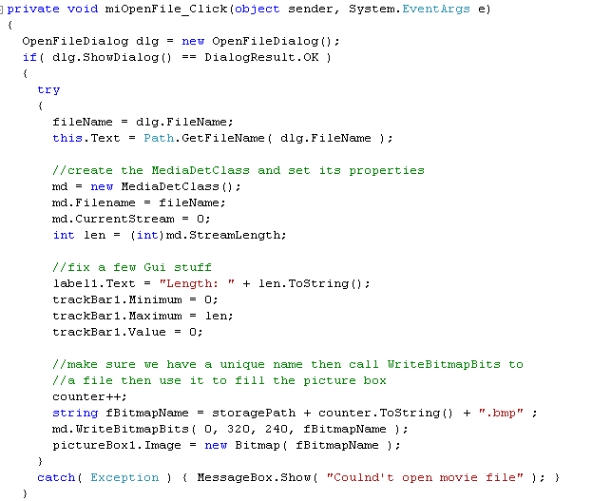
Open File

Slide 29
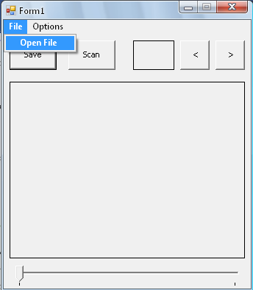
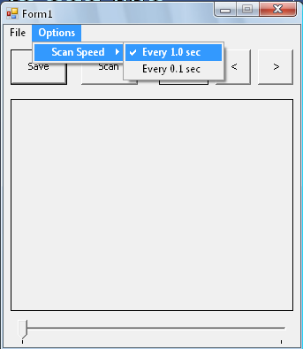


Play a Movie File

Slide 30










Slide 31
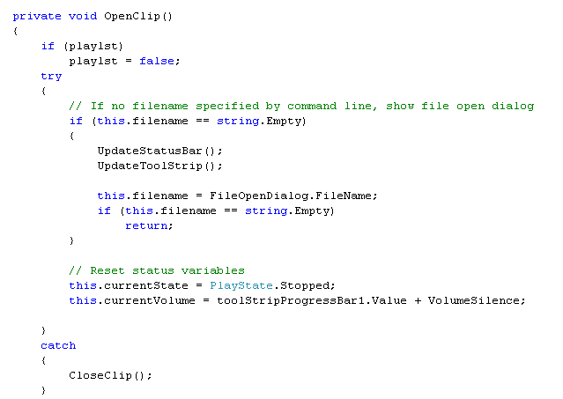
Movie Show Code

Slide 32
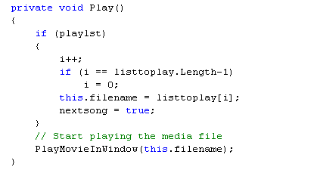
Play

Slide 33
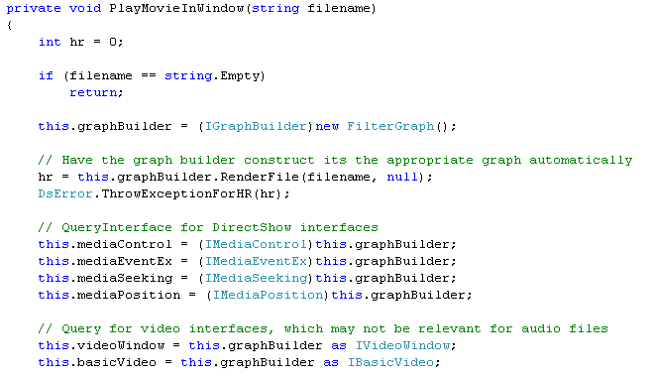
Play Movie Window

Slide 34
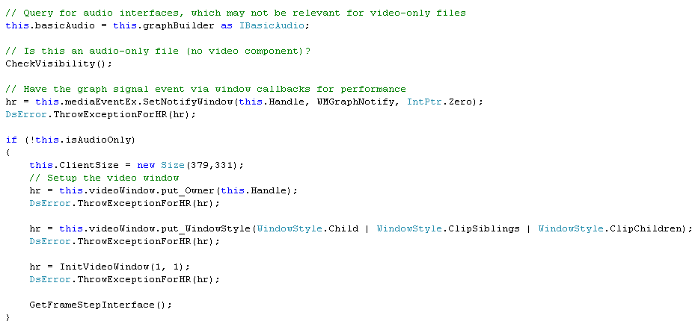

Slide 35
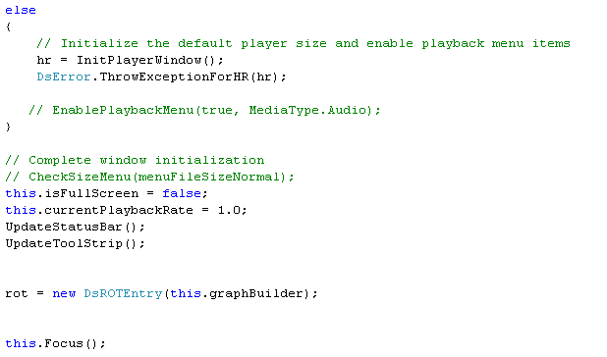

Slide 36
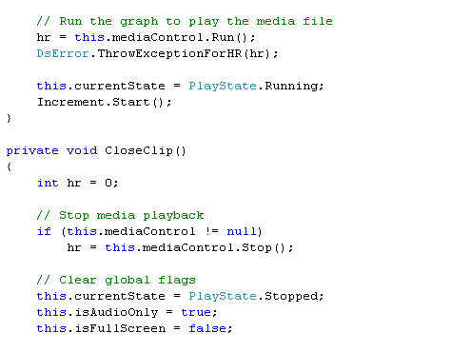

Slide 37
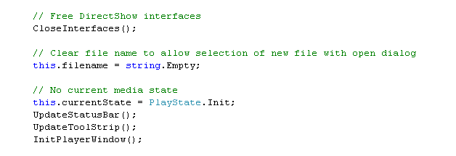

Slide 38
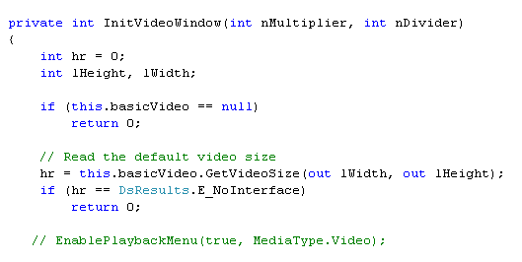
Init Video Window

Slide 39
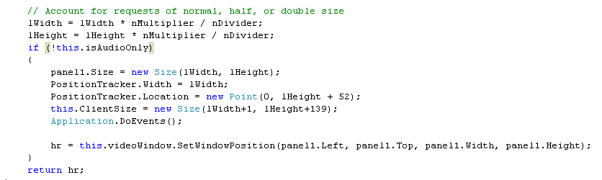

Slide 40
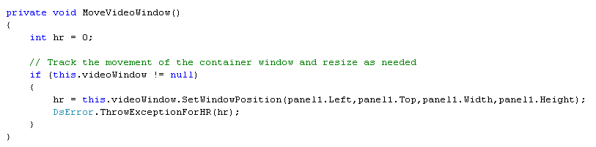
Move Video Window

Slide 41
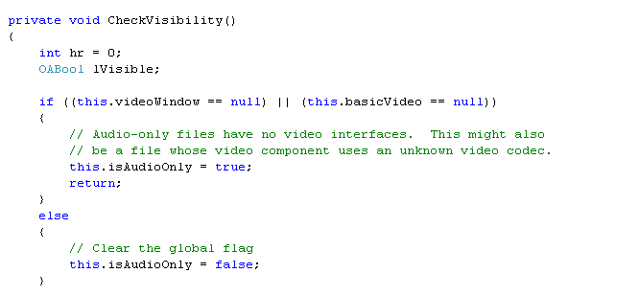
Check Visibility

Slide 42
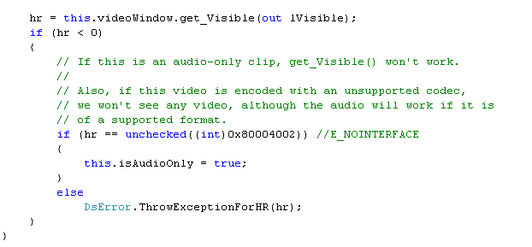

Slide 43
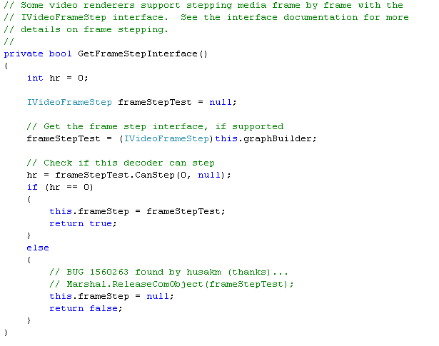
Get Frame Interface

Slide 44
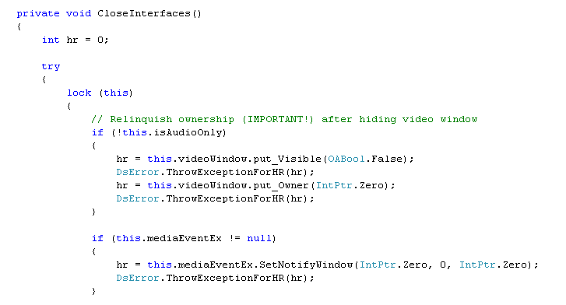
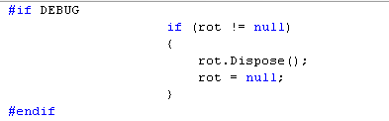
Close Interface

Slide 45
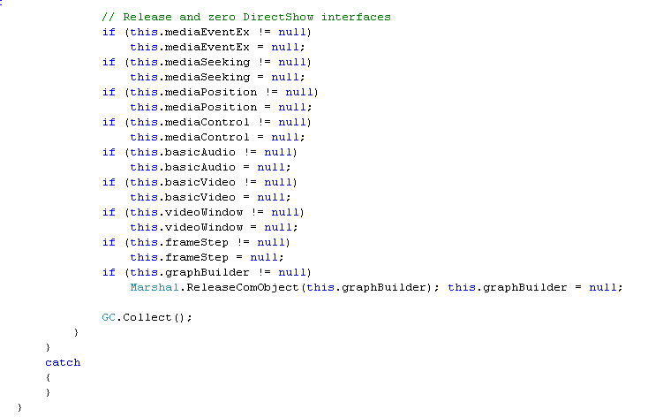

Slide 46
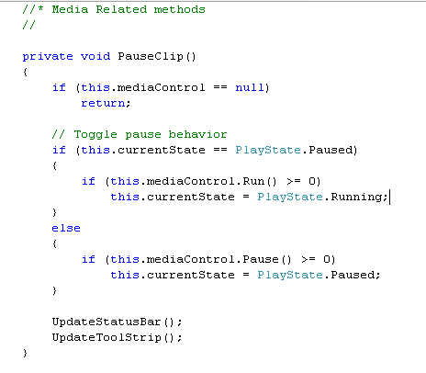
Pause clip

Slide 47
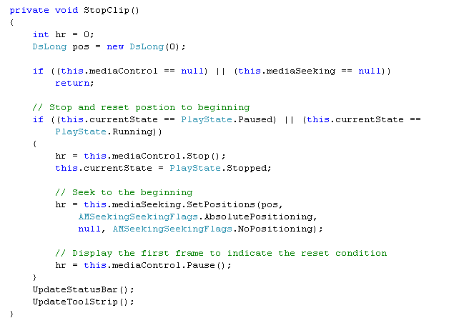
Stop Clip

Slide 48
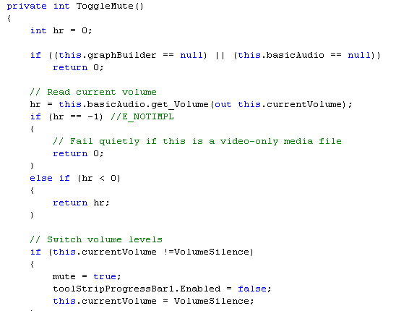
Toggle Mute

Slide 49
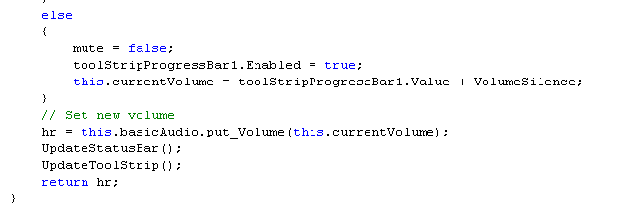

Slide 50
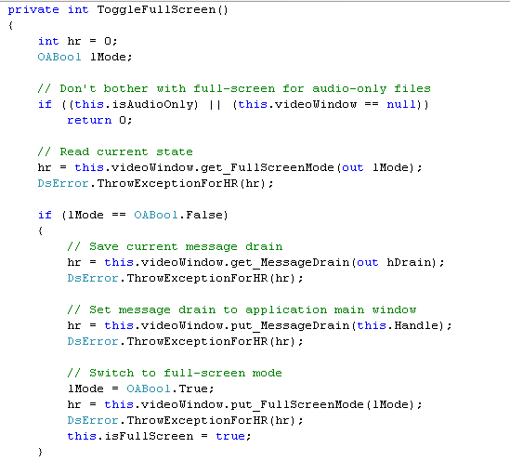
Full Screen

Slide 51
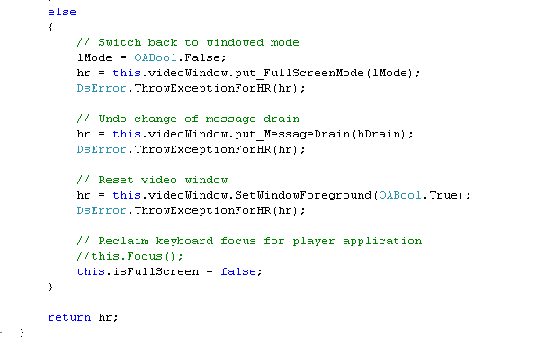

Slide 52
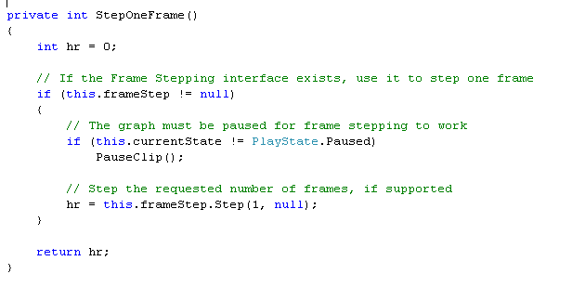
Step one Frame

Slide 53

Step Frames

Slide 54

Modify Rate

Slide 55

Set Rate

Slide 56

Handle Graph Event

Slide 57


Slide 58

Related Method

Slide 59

Init play window

Slide 60

Update Status bar

Slide 61


Slide 62


Slide 63

Update Tool Strip

Slide 64

Playing program using Keyboard

Slide 65


Slide 66


Slide 67

Main form actions

Slide 68

Record Button

Slide 69

Open & close CD Tray

Slide 70

File Menu

Slide 71

Position Tracker

Slide 72


Slide 73

Play List

Slide 74


Slide 75

Volume Control

Slide 76

Subtitle

Slide 77


Slide 78


Slide 79


Slide 80


Slide 81


This is the end of the story…..
Thank you

